Slide 1


Sql Project
This Photo by Unknown author is licensed under CC BY-SA.
This Photo by Unknown author is licensed under CC BY-NC.
An analysis of E commerce data.
By Jacob Cyr.

Slide 2
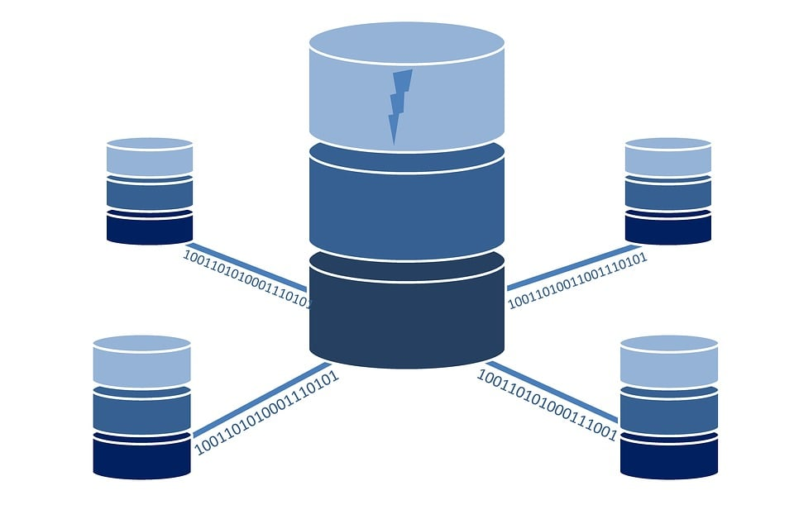
Project Flow and data Exploration
Data Exploration -data exploration -data cleaning and transformation -data analysis -Qa process
-additional metrics, dimensions, and statistical tests.

Slide 3

Data Exploration
-gain an understanding of available tables and their domains.
-identify key variables and relationships with the data.

Slide 4

Data Cleaning and Transformation.
-Clean the data by addressing duplicate records, missing values, and formatting inconsistencies.
-Perform necessary data transformations to prepare it for analysis.

Slide 5
Data Analysis and valuable insights
Average time on site for visitors who made a purchase
Visitors with the highest total transaction revenue
Number of unique visitors
Total number of sessions for each country (limit 5)
Total revenue generated per day by visitor within a specific date range

Slide 6
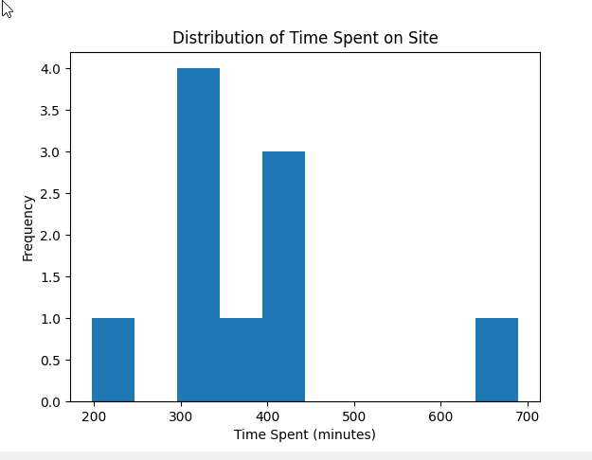
Pyplot Graph

Slide 7


QA process
Issues regarding the QA process -duplicate records -missing values -incorrect formatting -random sample inspection
-calculation verification

Slide 8
Further Analysis.
-Conduct further analysis on the relationship between revenue and other variables.
-Explore additional metrics and dimensions to gain deeper insights.
-Perform statistical tests to validate hypotheses and identify significant patterns.

Slide 9
Conclusion
Better understanding of visitor behavior, revenue generation, and country-wise session distribution. Code Examples are in the project repository.

